Slide 1
Hardware Trojan: Observing the Invisible
Nathanael Weidler
Dallin Marshall
Sam Mitchell

Slide 2
Objective
Leak the DES encryption key
Remove correlation between the key and the output
Remain undetected
Notes:
How presentation will benefit audience: Adult learners are more interested in a subject if they know how or why it is important to them.
Presenter’s level of expertise in the subject: Briefly state your credentials in this area, or explain why participants should listen to you.

Slide 3
Karri’s Taxonomy
Insertion stage
Perpetrated by designer
Abstraction
Gate level
Activation
Input sequence
Effects
Leak information
Location
I/O Port
Notes:
Lesson descriptions should be brief.

Slide 4
The crime was committed
By the designer
At the gate level
With the candlestick

Slide 5
Modified Taxonomy
Physical
Size and threat model
Activation
Triggering mechanism
Action
Leakage method
Notes:
Example objectives
At the end of this lesson, you will be able to:
Save files to the team Web server.
Move files to different locations on the team Web server.
Share files on the team Web server.

Slide 6
Physical size
 | Baseline | Trigger | Trojan | Final
Flip Flops | 487 | 4 | 80 | 571
4-input LUT | 883 | 22 | 101 | 1006
Total logic elements | 1370 | 26 | 181 | 1577

Slide 7
Trigger method
Sequence of plaintext least significant nibble (4 bits)
2²⁴ potential sequences
Testing will likely miss this by repeating or incrementing this nibble

Slide 8
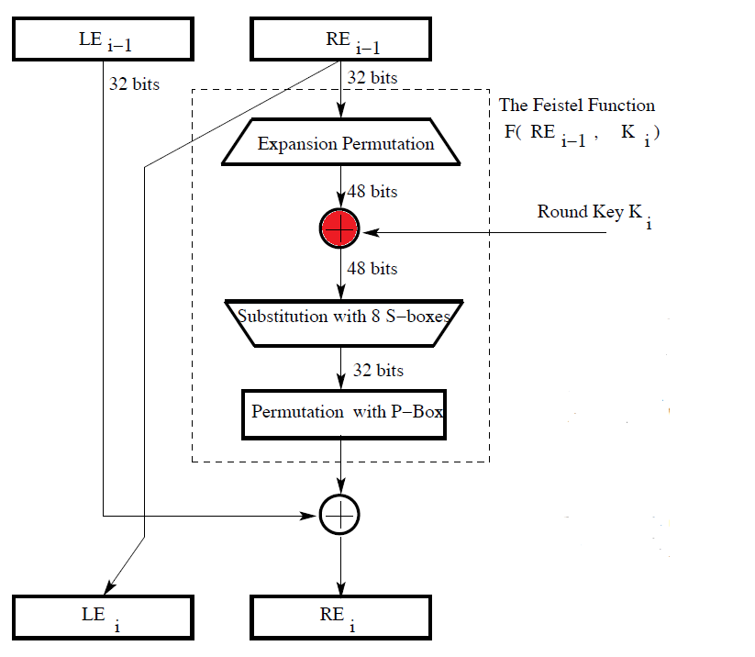
Key obfuscation
Targeted round key xor operation
Input from Expansion Permutation
Output
Leaked from round 9 of DES
Key correlation removed
No additional logic required

Slide 9
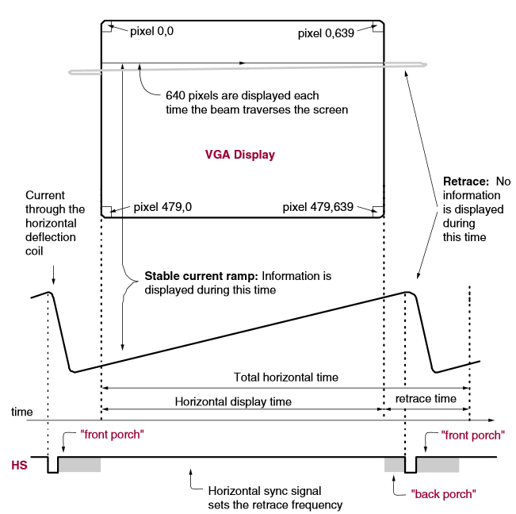
Leaking method: Back porch
Monitor displays plaintext and ciphertext
VGA display requires an offscreen buffer zone
Called a front and back porch
Display by altering offscreen pixels

Slide 10
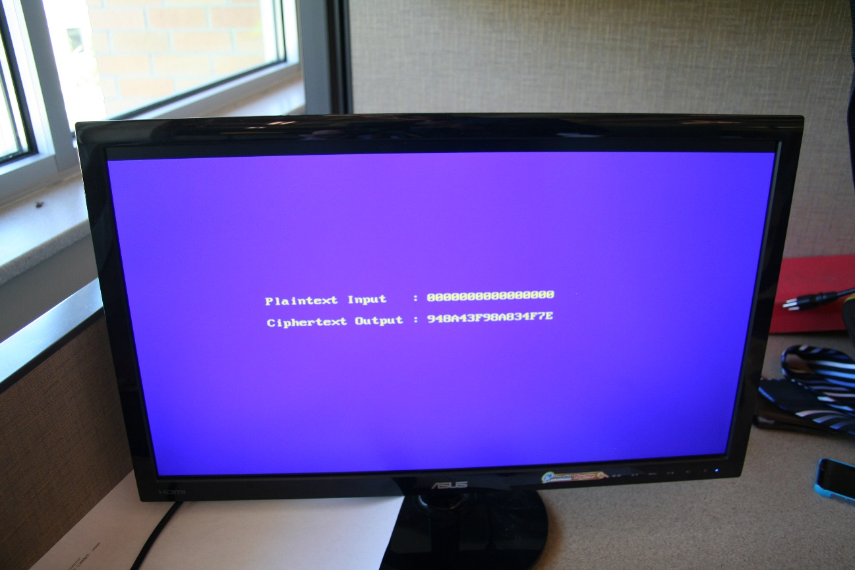
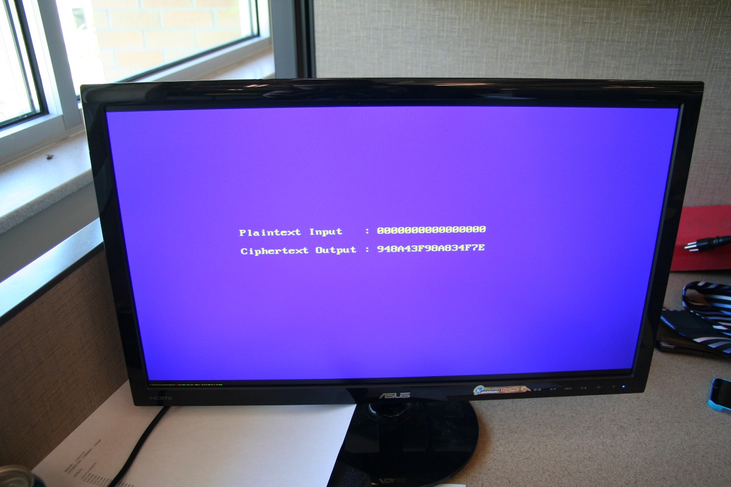
Trojan output
Monitor sans shift
Monitor displaying compromised data

Slide 11
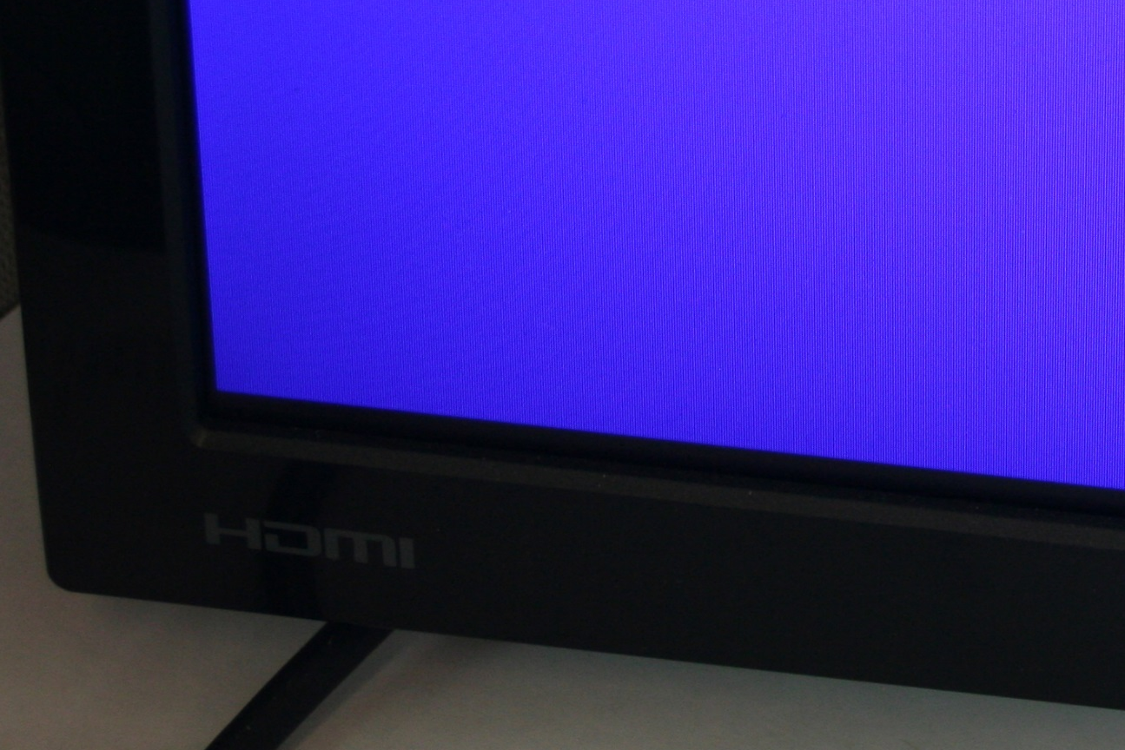
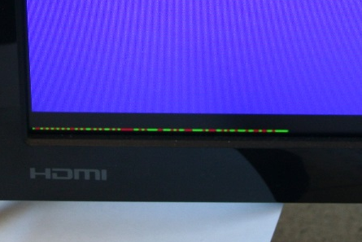
Trojan output: 96 bits

Slide 12
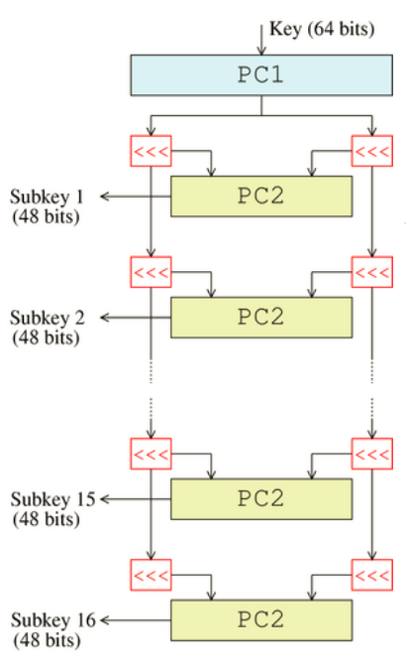
Key recovery
Xor 48-bit strings to obtain round key
Round key is a permuted version of original
Traverse permutations to 56-bit key
8 bits are missing
Use 56-bit key guess to generate 64-bit key
Encrypt plaintext and compare ciphertexts

Slide 13
Demo!

Slide 14
Questions?

Slide 15
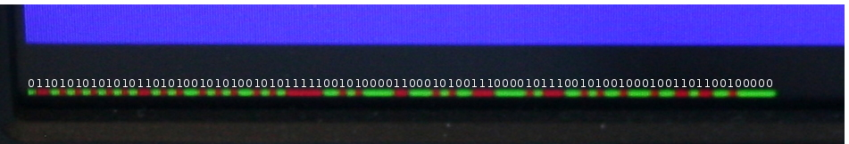
Output bitstream

